Slide 1

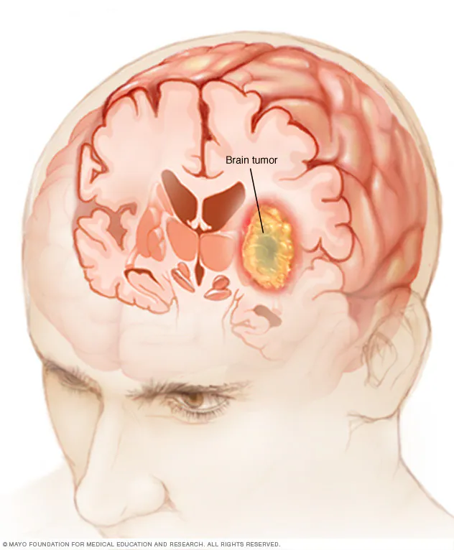
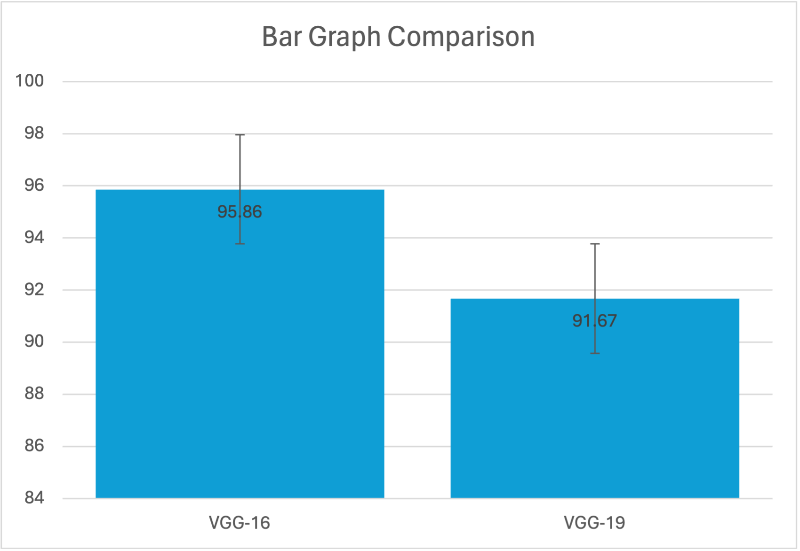
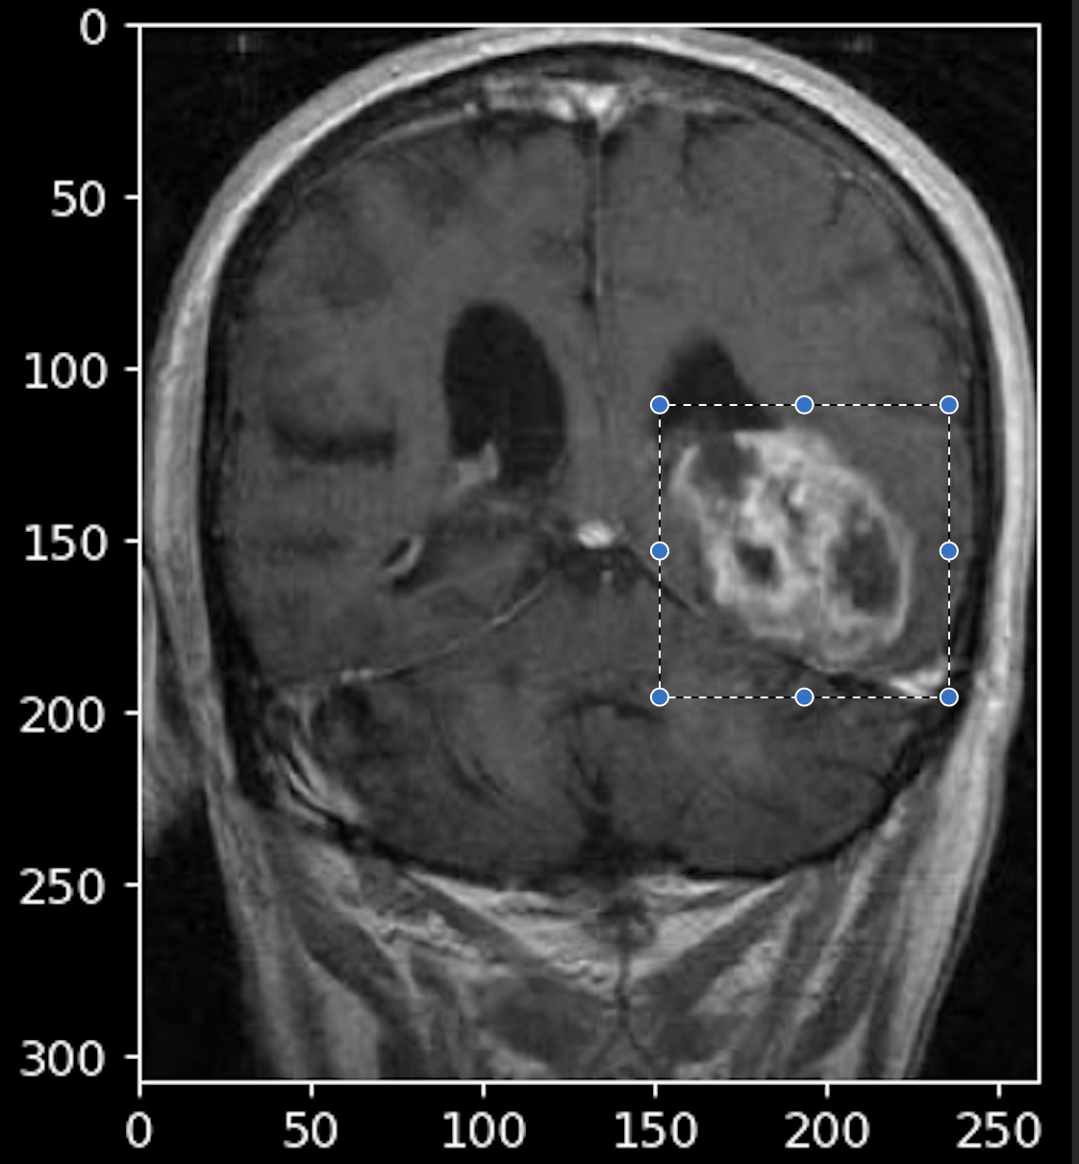
Name: Mr. Sunil Shuraj N
Register Number:192224019
Guided by Dr. Sivagami S
Ms. Poorani.S
Guided by Dr. Mary Valantina. G
Analyzing Brain Tumor Detection using VGG-16 and VGG-19 for Enhanced Accuracy
INTRODUCTION
Brain tumor detection represents a critical area of concern in medical diagnostics, given its multifaceted etiology involving genetic mutations and environmental factors, which can profoundly impact individuals' health and diminish their quality of life.
This study delves into the comparative efficacy of two prominent approaches for brain tumor detection: employing the VGG-16 and VGG-19 models to enhance accuracy. These models, renowned for their deep architecture and feature extraction capabilities, offer promising avenues for improving the precision of brain tumor diagnosis.
In this research, we specifically investigate the performance of the Hybrid VGG-19 (Visual Geometry Group 19) model in contrast to the VGG-16 (Visual Geometry Group 16), aiming to elucidate their respective strengths and limitations in accurately detecting brain tumors.
By meticulously analyzing these methodologies, machine learning algorithms demonstrate their potential to not only accurately identify brain tumors but also to provide valuable insights into tumor characteristics and behavior, facilitating tailored treatment strategies and improving patient outcomes.
Furthermore, the utilization of advanced deep learning techniques like the VGG-16 and VGG-19 models underscores the growing importance of artificial intelligence in augmenting medical diagnostics, paving the way for more efficient and reliable methods of brain tumor detection.
This introduction offers a comprehensive overview of the methodologies available for predictive analysis in brain tumor detection using machine learning, highlighting the significance of leveraging cutting-edge technologies to address the challenges inherent in diagnosing and treating this complex condition.
Brain Tumor
MATERIALS AND METHODS
VGG-16
Better Accuracy
Result Analysis
Train Data
Feature Extraction
Data Collection/
Pre -Processing
VGG-19
Test Data
Predictive Analysis for Brain Tumor Detection
RESULT
Group Statistics
Accuracy | Algorithm | N | Mean | Std.Deviation | Std.Error Mean
 | VGG-16 | 20 | 95.86 | 0.096 | 0.37333
 | VGG-19 | 20 | 91.67 | 0.306 | 0.58945
VALUES
Error Bars: 95% Cl
Error Bars +/- 2 SD
Fig2 : Brain Tumor Detection Using Visual Geometry Group 16 and Visual Geometry Group 19
Fig1: VGG-16 always outperforms VGG-19 in accuracy, showcasing its superiority for predictive tasks. These consequences verify VGG-16 reliability and performance over VGG-19
Table 1 shows the mean values for VGG-19 and VGG-16 in terms of mean accuracy, standard deviation, and standers error mean. Furthermore, Visual Geometry Group 16 exhibits a better mean accuracy, as is shown.
DISCUSSION AND CONCLUSION
The examination reveals a notable contrast in precision between Visual Geometry Group-16 (VGG-16) and Visual Geometry Group-19 (VGG-19) models in brain tumor detection. VGG-16 demonstrates an overall accuracy of 95.85%, surpassing VGG-19, which achieves 91.67%.
Moreover, the statistical analysis, with a significance value (p-value) of 0.001789 from the independent sample T-test (where p<0.05), indicates a statistically significant distinction between the two groups. This underscores the superiority of VGG-16 over VGG-19 in terms of accuracy.
It is evident from this investigation that the VGG-16 model exhibits remarkable accuracy, positioning it as a promising tool for enhancing brain tumor detection. While both VGG-16 and VGG-19 algorithms offer predictive capabilities in this domain, VGG-16 stands out for its higher accuracy, suggesting its potential as a preferred choice for brain tumor diagnosis.
The findings emphasize the importance of selecting appropriate deep learning models for specific medical diagnostic tasks and suggest that VGG-16 could play a crucial role in advancing the accuracy and reliability of brain tumor detection algorithms.
BIBLIOGRAPHY
Louis, David N., et al. "The 2016 World Health Organization Classification of Tumors of the Central Nervous System: a summary." Acta Neuropathologica, vol. 131, no. 6, 2016, pp. 803-820.
Akkus, Zeynettin, et al. "Deep learning for brain tumor classification." Proceedings of the IEEE conference on computer vision and pattern recognition workshops, 2017, pp. 56-65.
Menze, Bjoern H., et al. "The multimodal brain tumor image segmentation benchmark (BRATS)." IEEE Transactions on Medical Imaging, vol. 34, no. 10, 2015, pp. 1993-2024.
El-Dahshan, Eman-SA, et al. "Hybrid intelligent techniques for MRI brain images classification." Digital Signal Processing, vol. 20, no. 2, 2010, pp. 433-441.
Ertosun, Mehmet Gökhan, and Uğur Sevik. "Automated brain tumor detection and segmentation using U-Net based fully convolutional networks." 2019 Medical Technologies National Conference (TIPTEKNO), 2019, pp. 1-6.
Baid, Urvashi, et al. "MRI based brain tumor segmentation using improved K-means clustering and SVM." Procedia Computer Science, vol. 85, 2016, pp. 348-355.

